Slide 1
Backend Web Development Sessions (2 & 3)
By Ahmed Mamdouh

Slide 2
Flow Control
Most of the time we need our programs to behave differently depending on different conditions or to repeat a task for a multiple times, for these reasons we use flow control.
Types of Flow Control:-
Conditional Statements (if-else statements, switch statements)
Loop statements (while, do-while, for loops)

Slide 3
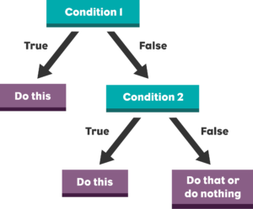
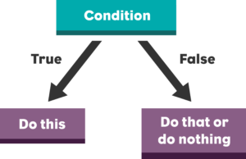
Conditional Statements

Slide 4
If-else Statements
$a = 2;
$b = 2;
if ($b > 5) {
echo $a - $b;
}
// outputs nothing

Slide 5
If-else Statements
$a = 2;
$b = 2;
if ($b > 5) {
echo $a - $b;
} else {
echo $a + $b;
}
// outputs $a + $b = 4

Slide 6
If-else Statements
$a = 2;
$b = 2;
if ($b > 0 && $b <= 5) {
echo $a * $b;
} else if ($b > 5 && $b < 10) {
echo $a + $b;
} else {
echo $a - $b;
}
// outputs $a * $b = 4

Slide 7
Switch Statements
$number = 1;
switch ($number) {
case 1:
echo "The number is one";
break;
case 2:
echo "The number is two";
break;
default:
echo "I don't know this number";
}
// outputs "The number is one"

Slide 8
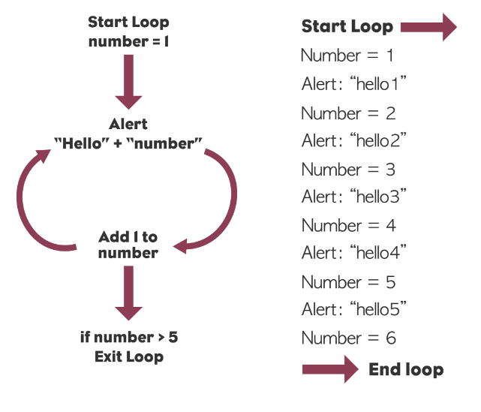
Loop Statements

Slide 9
Main Components of Loop Statements
Initialization (statement to assign initial value to loop control variable)
Continuation Condition (condition for loop to either continue if that condition evaluates to true or exit the loop if the condition evaluates to false)
Incrementor or Decrementor (statement to change the value of the loop control variable)
Loop body (statements to be executed if the continuation condition evaluates to true)

Slide 10
For Loop Statement
for ($i = 1; $i <= 10; $i++) {
echo "Hello $i";
}
// Initialization ($i = 1)
// Continuation Condition ($i <= 10)
// Incrementor ($i++)
// Loop Body (echo "Hello $i")

Slide 11
While Loop Statement
$i = 1;
while ($i <= 10) {
echo "Hello $i";
$i++;
}
// Loop Variable ($i)
// Initialization ($i = 1)
// Continuation Condition ($i <= 10)
// Loop Body (echo "Hello $i")
// Incrementor ($i++)
// In the while loop the loop variable must be initialized before the the while statement and the incrementor/decrementor must be inside the loop body

Slide 12
Do-While Loop Statement
$i = 1;
do {
echo "Hello $i";
$i++;
} while ($i <= 10);
// Loop Variable ($i)
// Initialization ($i = 1)
// Continuation Condition ($i <= 10)
// Loop Body (echo "Hello $i")
// Incrementor ($i++)
// In the do-while loop the loop variable must be initialized before the the do-while statement and the incrementor/decrementor must be inside the loop body

Slide 13
While Loop vs. Do-While Loop
What is the difference between the while and do-while loops???

Slide 14
While Loop vs. Do-While Loop
In the while loop the condition is evaluated first then if it is true the loop body statements run, else the loop body is skipped entirely.
In the do-while loop the loop body statements run first then the condition is evaluated.
So the do-while loop guarantees that the loop body statements will be executed at least once even if the condition in the do-while statement is initially false.

Slide 15
Arrays
According to our knowledge so far, if we want to save six colors in our program into variables (red, green, yellow, blue, black, white) we would do the following:-
$color1 = "red";
$color2 = "green";
$color3 = "yellow";
$color4 = "blue";
$color5 = "black";
$color6 = "white";

Slide 16
Arrays
Using multiple variables like the last example is considered inefficient as for every new color we will have to create a new variable, so we use a special type called array which is one variable but can hold multiple values
// First Method
$colors = array("red", "green", "yellow", "blue", "black", "white");
// Second Method
$colors = ["red", "green", "yellow", "blue", "black", "white"];

Slide 17
Types of Arrays in PHP
Indexed Array (Arrays are assigned by indices starting from 0)
Associative Array (Arrays are assigned by keys (similar to dictionaries in other Python and Java and to objects in JavaScript)
Multidimensional Array (When array values are another arrays)

Slide 18
Indexed Arrays
Indexed arrays are arrays that are arranged by indices which are numbers started from 0 till (n – 1) where n is number of items in the array.
To access a specific item in the array it is called by its index
echo $colors[0] // Outputs "red"
echo $colors[1] // Outputs "green"
echo $colors[3] // Outputs "blue"
echo $colors[5] // Outputs "white"

Slide 19
Associative Arrays
Associative arrays are arrays that are used to store key-value pairs.
To access a specific value in an associative array we call it by its key
// First Method
$student = array(
'name' => 'Mohammed',
'age' => 25
);
// Second Method
$student = [
'name' => 'Mohammed',
'age' => 25
];
echo $student['name']; // Outputs "Mohammed"
echo $student['age']; // Outputs 25

Slide 20
Multidimensional Arrays
Array elements can be another arrays in this case those arrays are called multidimensional arrays
To access values of inner arrays we use the indices of both outer and inner arrays
$grid = [
[1, 2, 3],
[4, 5, 6],
[7, 8, 9]
];
echo $grid[0][1]; // Outputs 2
echo $grid[1][0]; // Outputs 4
echo $grid[1][2]; // Outputs 6
echo $grid[2][1]; // Outputs 8

Slide 21
Iterating over Arrays
Loops are used to iterate over arrays to list array elements
// For Loop
for ($i = 0; $i < count($colors); $i++) {
echo $colors[$i];
}
// count function returns the number of items in array
// Foreach Loop
foreach ($colors as $color) {
echo $color;
}

